Slide 1

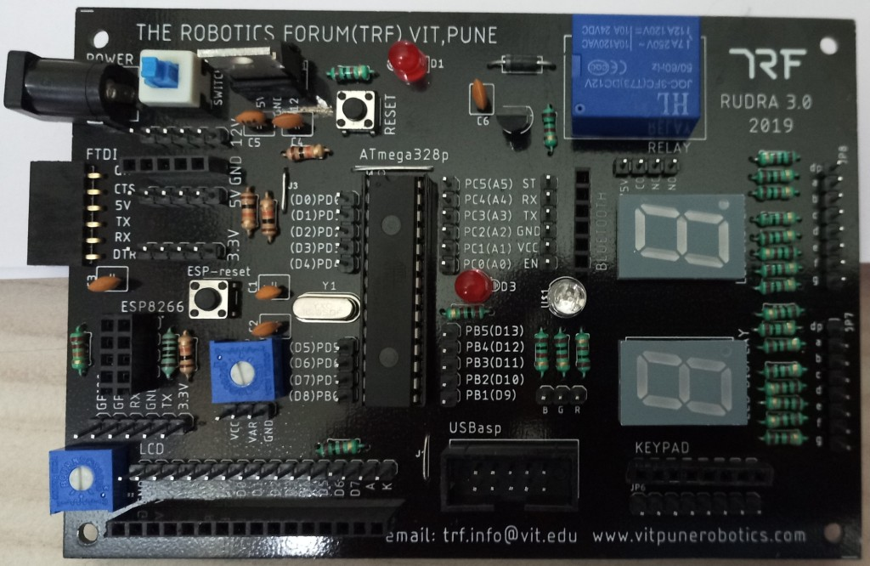
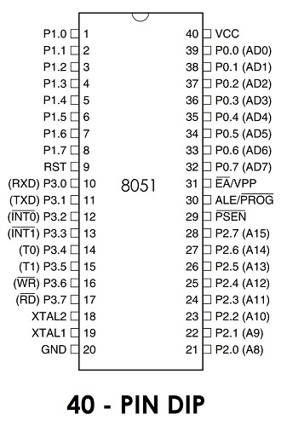
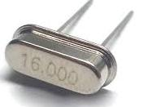
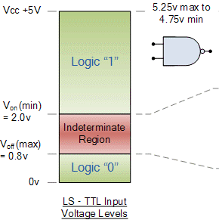
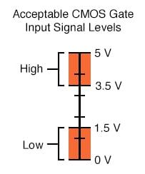
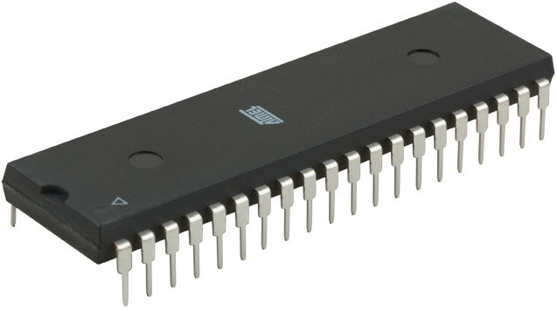
Micro Controllers – 2.3
8051 continued ….
FY – DESH – VIT
Vishwakarma Institute of Technology
FY - Department of Engineering, Sciences and Humanities

Slide 2
Addressing modes of 8051 :-
Addressing mode – It is a way to tackle / handle the Operand i.e. the Data or a way to deal with the Data.
Different addressing modes of 8051 –
1) Immediate Addressing Mode
2) Register Addressing Mode
3) Direct Addressing Mode
4) Register Indirect Addressing Mode
5) Indexed Addressing Mode
Vishwakarma Institute of Technology
FY - Department of Engineering, Sciences and Humanities

Slide 3
Addressing modes of 8051 :-
Immediate Addressing Mode – Here the data to be transported is a part and parcel of the instruction itself.
e.g.
MOV A, #45H; Hexadecimal number 45 will be moved to Acc.
Or
MOV R3, #0A3H; Hexadecimal number A3 will be moved to Register R3.
Size of the data and size of the register should be same. (MOV A, #245H; is illegal)
# indicates that 45 is the data and not the address of a register.
0 (zero) is added prior to A, indicating that A is Hexadecimal number and not a character.
Vishwakarma Institute of Technology
FY - Department of Engineering, Sciences and Humanities

Slide 4
Addressing modes of 8051 :-
2) Register Addressing Mode – Here the data to be transported is stored in a register of source or destination and the name of the register is in the instruction.
e.g.
MOV A, R6; Contents of register R6 are shifted to Acc.
Or
MOV R3, A; Contents of Accumulator are shifted to register R3
Register Banks are named as R0 to R7 only with respective addresses as 00H to 1FH.
Proper precaution should be taken while coding the PSW.
Register to Register transfer is not allowed. Thus, MOV R5, R6; is illegal.
Vishwakarma Institute of Technology
FY - Department of Engineering, Sciences and Humanities

Slide 5
Addressing modes of 8051 :-
3) Direct Addressing Mode –
e.g.
MOV R2, 45H;
here the data stored in the RAM location 45 H is moved to register R2.
Understand the difference between #45H and 45H
The 128 RAM locations are 00H to 7FH
The SFRs have addresses starting from 80H to F0H (with gaps)
MOV 80H, #0A6H; here 80H is address of P0
MOV P0, #0A6H; here directly the port P0 is mentioned
Vishwakarma Institute of Technology
FY - Department of Engineering, Sciences and Humanities

Slide 6
–: Addresses of the 21 SFRs :–
8A – TL0 80 – P0 (Port 0)
8B – TL1 90 – P1 (Port 1)
8C – TH0 A0 – P2 (Port 2)
8D – TH1 B0 – P3 (Port 3)
88 – TCON E0 – A (Accumulator)
89 – TMOD F0 – B (Extension of A)
98 – SCON 81 – SP
99 – SBUF D0 – PSW
82 – DPL A8 – IE (Interrupt ??)
83 – DPH B8 – IP (Interrupt ??)
87 – PCON
Note – There are gaps in the addresses of the SFRs.
Put a leading 0 if the address starts with a alphabet. e.g. 0A0, 0E0
Vishwakarma Institute of Technology
FY - Department of Engineering, Sciences and Humanities

Slide 7
Addressing modes of 8051 :-
4) Register Indirect Addressing Mode – Here a register will have an address in it and at that address there will be some data stored.
MOV A, @R0;
here the data stored in the register is say for e.g. 3CH. This is a RAM location where the actual data will be found. That data will be moved to the Acc.
“Only R0 and R1” can be addressed from all banks.
R0 and R1 are called as pointer registers in the Reg. Indirect Addressing Mode.
Vishwakarma Institute of Technology
FY - Department of Engineering, Sciences and Humanities

Slide 8
Addressing modes of 8051 :-
5) Indexed Addressing Mode –
MOVC A, @A+DPTR;
MOVC A, @A+PC;
Current contents of Acc. are added to contents of the DPTR. This will give a new number, which is address of memory location where the data is stored.
DPTR has 16 bit address (DPH and DPL) which is added to 8 bit contents of Acc.
Destination is always Acc.
e.g. DPTR = 01F3H and A = 08H
Find the address …..
Vishwakarma Institute of Technology
FY - Department of Engineering, Sciences and Humanities
Ans = 01FB

Slide 9
Port Configuration of 8051 :-
Port 0 – Pins 32 to 39 − It serves as I/O port. Lower order address and data bus signals are multiplexed using this port.
Port 1 – Pins 1 to 8 − Only bi-directional I/O port.
Port 2 – Pins 21 to 28 − This port serves as I/O port. Higher order address bus signals are also multiplexed using this port.
Port 3 – Pins 10 to 17 − This port serves as I/O port and few more functionalities like interrupts, timer input, External memory read and write, serial communication signals like RXD, TXD, etc.
Vishwakarma Institute of Technology
FY - Department of Engineering, Sciences and Humanities

Slide 10

8051 Microcontroller Special function registers SFRs
Vishwakarma Institute of Technology
FY - Department of Engineering, Sciences and Humanities

Slide 11
Special Function Registers (SFRs)
In 8051 microcontroller there are certain registers which use the RAM addresses from 80H to FFH and they are meant for certain specific operations. (Upper 128 bytes).
These registers are called Special function registers (SFRs).
Some of these registers are bit and byte addressable.
Some of SFRs are related to I/O ports (P0,P1,P2 and P3) and some are meant for control operations (TCON,SCON, PCON..) and remaining are the auxiliary SFRs.
SFRs Memory addresses are only direct addressable. Even though some of the addresses between 80H and FFH are not assigned to any SFR, they cannot be used as additional RAM area.
Out of these 128 Memory Locations (80H to FFH), there are only 21 locations that are actually assigned to SFRs.
Each SFR has one Byte Address and also a unique name which specifies its purpose. Since the SFRs are a part of the Internal RAM Structure, you can access SFRs as if you access the Internal RAM.
Vishwakarma Institute of Technology
FY - Department of Engineering, Sciences and Humanities

Slide 12
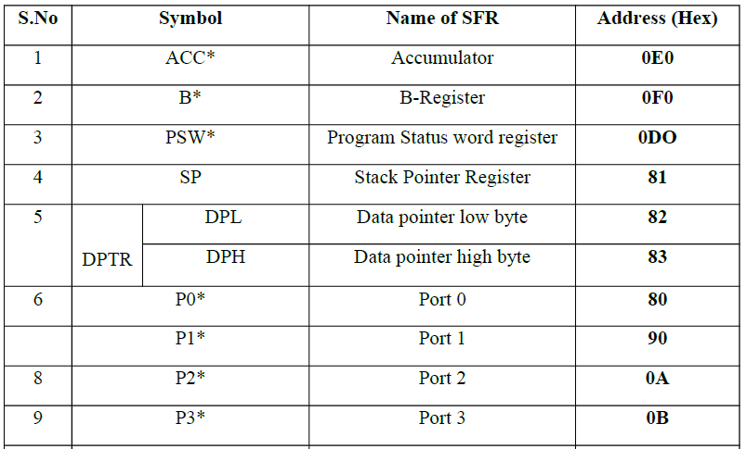
Special Function Registers (SFRs)
Vishwakarma Institute of Technology
FY - Department of Engineering, Sciences and Humanities
0A0
0B0
* Marked registers are bit and byte addressable, other registers are only byte addressable

Slide 13
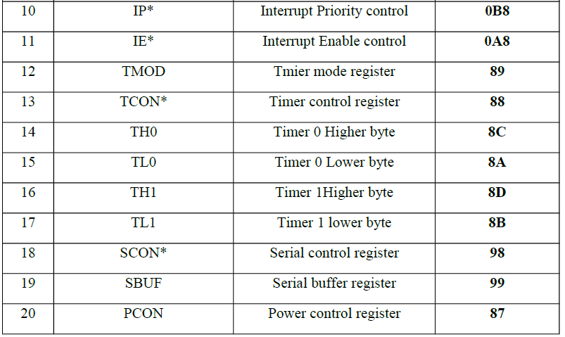
Special Function Registers (SFRs)
Vishwakarma Institute of Technology
FY - Department of Engineering, Sciences and Humanities
* Marked registers are bit and byte addressable, other registers are only byte addressable

Slide 14
1) SFR Register – Accumulator or A – E0H
ACC.7 ACC.6 ACC.5 ACC.4 ACC.3 ACC.2 ACC.1 ACC.0
Bit7 | Bit6 | Bit5 | Bit4 | Bit3 | Bit2 | Bit1 | Bit0
0E0H
E7 E6 E5 E4 E3 E2 E1 E0
The most important of all special function register is accumulator which is also known as ACC or A.
The Accumulator holds the result of most of arithmetic and logic operations.
To access the first bit (bit 0) or to access accumulator as a single byte (all 8 bits at once), A is accessed by direct addressing and its physical address is E0H.
Accumulator is both byte and bit addressable. If you want to access the second bit (bit 1), you may use E1H and for third bit E2H and so on.
Vishwakarma Institute of Technology
FY - Department of Engineering, Sciences and Humanities

Slide 15
2) SFR--Register B: F0H
B.7 B.6 B.5 B.4 B.3 B.2 B.1 B.0
Bit7 | Bit6 | Bit5 | Bit4 | Bit3 | Bit2 | Bit1 | Bit0
0F0H
F7 F6 F5 F4 F3 F2 F1 F0
Bit and byte addressable
The major purpose of this register is in executing multiplication and division.
The 8051 micro controller has a single instruction for multiplication (MUL) and division (DIV). Ex: MUL A,B – When this instruction is executed, data inside A and data inside B is multiplied and answer is stored in A.
Note: For MUL and DIV instructions, it is necessary that the two operands must be in A and B. Register B is also byte addressable and bit addressable. To access bit o or to access all 8 bits (as a single byte), physical address F0 is used. To access bit 1 you may use F1 and so on.
Vishwakarma Institute of Technology
FY - Department of Engineering, Sciences and Humanities

Slide 16
3) Stack Pointer SP: 81H
Bit7 | Bit6 | Bit5 | Bit4 | Bit3 | Bit2 | Bit1 | Bit0
81H
Stack pointer represents a pointer to the system stack.
Stack pointer is an 8 bit register, the direct address of SP is 81H and it is only byte addressable, which means you cannot access individual bits of stack pointer.
The content of the stack pointer points to the last stored location of system stack. To store something new in system stack, the SP must be incremented by 1 first and then execute the “store” command.
Usually after a system reset SP is initialized as 07H and data can be stored to stack from 08H onwards. This is usually a default case and programmer can alter values of SP to suit his/her needs.
Vishwakarma Institute of Technology
FY - Department of Engineering, Sciences and Humanities

Slide 17
4) Program Status Word (PSW): D0H
PSW.7 PSW.6 PSW.5 PSW.4 PSW.3 PSW.2 PSW.1 PSW.0
CY | AC | F0 | RS1 | RS0 | OV | -- | P
0D0H
D7 D6 D5 D4 D3 D2 D1 D0
Carry flag Parity flag
Auxiliary Carry Flag User definable flag
General purpose status flag Overflow flag
Register bank select bit1 Register bank select0
Vishwakarma Institute of Technology
FY - Department of Engineering, Sciences and Humanities
This is a vital SFR in the functioning of micro controller.
This register reflects the status of the operation that is being carried out in the processor.
PSW Register is both bit and byte addressable. The physical address of PSW starts from D0H. The individual bits are then accessed using D1, D2 … D7.

Slide 18
4) Program Status Word (PSW)
Bit No | Bit Symbol | Direct Address | Name | Function
0 | P | D0 | Parity | This bit will be set if ACC has odd number of 1’s after an operation. If not, bit will remain cleared.
1 | – | D1 |  | User definable bit
2 | OV | D2 | Overflow | OV flag is set if there is a carry from bit 6 for signed number operation, but not from bit 7 of an Arithmetic operation.
3 | RS0 | D3 | Register Bank select | LSB of the register bank select bit. Bit 0
4 | RS1 | D4 | Register Bank select | MSB of the register bank select bits. Bit 1
5 | F0 | D5 | Flag 0 | User defined flag
6 | AC | D6 | Auxiliary carry | This bit is set if data is coming out from bit 3 to bit 4 of Acc during an Arithmetic operation.
7 | CY | D7 | Carry | Is set if data is coming out of bit 7 of Acc during an Arithmetic operation.
Vishwakarma Institute of Technology
FY - Department of Engineering, Sciences and Humanities

Slide 19
4) Program Status Word (PSW)
The selection of the register Banks in PSW and their addresses
RS1 | RS0 | Register Bank | Address
0 | 0 | Bank 0 | 00H-07H
0 | 1 | Bank 1 | 08H-0FH
1 | 0 | Bank 2 | 10H-17H
1 | 1 | Bank 3 | 18H-1FH
Vishwakarma Institute of Technology
FY - Department of Engineering, Sciences and Humanities
CY -- Carry flag
This flag is set whenever there is a carry out from the D7 bit. This flag bit is affected after an 8-bit addition or subtraction. It can also be set to 1 or 0 directly by an instruction such as “SETB C” and “CLR C” where “SETB C” stands for “set bit carry” and “CLR C” for “clear carry”.
AC -- Auxiliary carry flag
If there is a carry from D3 to D4 during an ADD or SUB operation, this bit is set; otherwise, it is cleared. This flag is used by instructions that perform BCD (binary coded decimal) arithmetic.

Slide 20
4. Program Status Word (PSW)
P -- Parity flag
The parity flag reflects the number of 1 s in the A (accumulator) register only. If the A register contains an odd number of Is, then P = 1. Therefore, P = 0 if A has an even number of Is.
OV -- Overflow flag
This flag is set whenever the result of a signed number operation is large, causing the high-order bit to overflow into the sign bit. In general, the carry flag is used to detect errors in unsigned arithmetic operations. The overflow flag is only used to detect errors in signed arithmetic operations
Vishwakarma Institute of Technology
FY - Department of Engineering, Sciences and Humanities

Slide 21
4. Program Status Word (PSW)
Impact of the ADD instruction on the flag bits CY, AC, and P of the PSW register.
1. MOV A, #38H 0011 1000
ADD A, # 2FH 0010 1111
0110 0111
CY = 0, AC = 1, P = 1 as ACC has five 1’s
2. MOV A, # 9CH 1001 1100
ADD A, # 64H 0110 0100
1 0000 0000
CY = 1, AC = 1, P = 0 as ACC has zero 1’s
3. MOV A, #88H 1000 1000
ADD A, #93H 1001 0011
1 0001 1011
CY = 1, AC = 0, P = 0 as ACC has four 1’s
Vishwakarma Institute of Technology
FY - Department of Engineering, Sciences and Humanities

Slide 22
Port -- 8051 internal i/o ports
P0, P1, P2 and P3 are byte addresses used to access and perform read or write or other operations
Direct 8-bit addresses of each are specified in the instructions
Addresses of bytes at P0– 080, Floating pins
P1– 090, Internal Pull-ups
P2– 0A0 Internal Pull-ups
P3─ 0B0. Internal Pull-ups
Truely Bidirectional
Quasi Bidirectional
Vishwakarma Institute of Technology
FY - Department of Engineering, Sciences and Humanities
The difference between the quasi-bidirectional port and the true bidirectional port
There is no pull-up resistor inside the bidirectional P0 port. It is true bidirectional.
Others are quasi… quasi-bidirectional I/O is a type of input-output port on an integrated circuit such as a PIA. It can be used as an input or output without the use of a control signal for data direction. At power-on the I/Os are HIGH.
A Peripheral Interface Adapter (PIA) is a peripheral integrated circuit providing parallel I/O interfacing for microprocessor systems. Ex IC 8255

Slide 23
5) Port 0 and Register P0 – 80H
P0.7 P0.6 P0.5 P0.4 P0.3 P0.2 P0.1 P0.0
Bit7 | Bit6 | Bit5 | Bit4 | Bit3 | Bit2 | Bit1 | Bit0
80H
87 86 85 84 83 82 81 80
P0 includes pins (32-39). It is an I/O port with some alternative functions.
When the external memory is used with microcontroller, then the lower address byte (addresses A0-A7) is applied on P0.
This is an open drain port. Open drain term is used for CMOS versions while, open collector term is used for TTL versions.
If external memory is not used, all bits of P0 are configured for I/O purposes.
P0 doesn’t contain built-in pull-up resistors. It is true bidirectional port.
Each pin must be connected to external pull up resistors of 10K, if port is to be used as I/O.
P0 Register is both bit and byte addressable.
Vishwakarma Institute of Technology
FY - Department of Engineering, Sciences and Humanities
23

Slide 24
6) Port 1 and Register P1 : 90H
P1.7 P1.6 P1.5 P1.4 P1.3 P1.2 P1.1 P1.0
Bit7 | Bit6 | Bit5 | Bit4 | Bit3 | Bit2 | Bit1 | Bit0
90H
97 96 95 94 93 92 91 90
Port 1 is a dedicated I/O port from pin 1 to pin 8.
It is generally used for interfacing to external device like LED, sensors, switches, motors etc.
Port pins are internally pulled up. As an I/O port: Standard quasi-bidirectional.
P1 is a true I/O port as it doesn’t have any alternative functions as in P0. It has a built-in pull-up resistors.
Writing 1 to each bit of a port configures that port as input while writing zero configures that as output. By default, port is configured as input on power-on.
P1 Register is both bit and byte addressable.
Vishwakarma Institute of Technology
FY - Department of Engineering, Sciences and Humanities

Slide 25
7) Port 2 and Register P2 -- A0 H
P2.7 P2.6 P2.5 P2.4 P2.3 P2.2 P2.1 P2.0
Bit7 | Bit6 | Bit5 | Bit4 | Bit3 | Bit2 | Bit1 | Bit0
A0H
A7 A6 A5 A4 A3 A2 A1 A0
Like port 0, port 2 is a dual-purpose port.(Pins 21 through 28)
Like P1 ,Port 2 also doesn’t require any pull-up resistors. As an I/O port: Standard quasi-bidirectional.
Alternate functions: High byte of address bus for external program and data memory accesses.
Writing 1 to each bit of a port configures that port as input while writing zero configures that as output. By default, port is configured as input on power-on
Register is both bit and byte addressable.
Vishwakarma Institute of Technology
FY - Department of Engineering, Sciences and Humanities

Slide 26
8) Port 3 and Register P3– B0 H
P3.7 P3.6 P3.5 P3.4 P3.3 P3.2 P3.1 P3.0
RD | WR | T1 | T0 | INT1 | INT0 | TXD | RXD
B0H
B7 B6 B5 B4 B3 B2 B1 B0
Port 3 is also dual purpose but designers generally avoid using this port for I/O because the pins have alternate functions which are related to special features of the 8051. Use of these pins may interfere with the normal operation of the 8051.
As an I/O port: Standard quasi-bidirectional.
Alternate functions:
Serial I/O - TXD, RXD
Timer clocks- T0, T1
Interrupts - INT0, NT1
Data memory- RD, WR
Register is both bit and byte addressable.
Vishwakarma Institute of Technology
FY - Department of Engineering, Sciences and Humanities

Slide 27
SCON - Serial Port Control Register
7
6
5
4
3
2
1
0
SM0
SM1
SM2
REN
TB8
RB8
TI
RI
Bit 0 = Receive Interrupt Flag =
Bit 1 = Transmit Interrupt Flag =
Bit 2 = Received Bit 8 =
Bit 3 = Transmitted Bit 8 =
Bit 4 = Receive Enable Bit =
Bit 5 = Multiprocessor Comm. Bit =
Bit 6 = Serial Port Mode Selection Bit 1 =
Bit 7 = Serial Port Mode Selection Bit 0 =
Vishwakarma Institute of Technology
FY - Department of Engineering, Sciences and Humanities

Slide 28
PCON function Registers
Power Mode Control
Vishwakarma Institute of Technology
FY - Department of Engineering, Sciences and Humanities
7
6
5
4
3
2
1
0
SM0D
--
--
--
GF1
GF0
PD
IDL

Slide 29
TCON Register
TF1
TR1
TF0
TR0
IE1
IT1
IE0
IT0
Vishwakarma Institute of Technology
FY - Department of Engineering, Sciences and Humanities

Slide 30
TMOD – 8 bit Register – Used to configure the Timers
GATE
C/T
M1
M0
GATE
C/T
M1
M0
Timer 1
Timer 0
C/T bit :–
= 1 = Counter is configured.
= 0 = Timer is configured.
M1 and M0 bits :– They together define the
Timer Mode. There are 4 modes.
M1 M0 Function
Mode 0 0 0 13 bit Timer
Mode 1 0 1 16 bit Timer
Mode 2 1 0 8 bit Auto Reload
Mode 3 1 1 Split Timer Mode
Vishwakarma Institute of Technology
FY - Department of Engineering, Sciences and Humanities

Slide 31
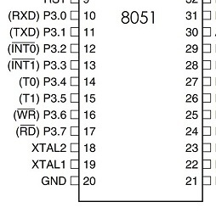
TMOD – 8 bit Register – Used to configure the Timers
GATE
C/T
M1
M0
GATE
C/T
M1
M0
Timer 1
Timer 0
GATE bit :-
= 0 means, Timer will be Run Mode when TRX bit of TCON is high and INT0 (or INT1) is high.
= 1 means, Timer will be Run Mode when TRX bit of TCON is high.
Vishwakarma Institute of Technology
FY - Department of Engineering, Sciences and Humanities

Slide 32
Micro Controllers – 2.3
8051 continued …
Thanks !
FY – DESH – VIT
Vishwakarma Institute of Technology
FY - Department of Engineering, Sciences and Humanities

